Slide 1
Predicting Popularity of Songs on Spotify
Andrew Gillock
Snehal Naravane
Vishwak Venkatesh
Boran Sheu
Noah Shimizu
Muskan Agarwal

Slide 2
Index
Introduction
EDA process
Feature engineering
Modelling
Conclusion: Summary of Modelling
Future steps & improvements
Notes:
First of all, we will start on the brief background of what motivated us to choose this topic.
And then we will go over the EDA process, tuning our features, the models we built to predict best outcomes, and finally the results of our models and future steps we might able to do to expand the project.

Slide 3
Prelude
“If Music is a Place — then Jazz is the City, Folk is the Wilderness, Rock is the Road, Classical is a Temple. – Vera Nazarin”
From rock to pop, soul to jazz, hip hop to rap, there has been a wide array of genres that are in vogue in each period of time. With artists being famed for their genre of choice, and artists experimenting across the categories, there has been a rollercoaster of music styles.
The interplay of the factors influencing music’s popularity is what drew us to this dataset.
Notes:
Well, people from all over the world listens to all kind of songs and it is quite hard to categorize songs and people's taste variable a lot. In the past, we can never say that a song will definitely go viral before it came out.
It makes us starting to wonder, if there is a pattern about how songs became hit songs, could artist or producer succeed by following data in the past?

Slide 4

Spotify
Online Music Streaming Platform
422 Million Unique Users
Most Users in Europe, NA, and Latin America
Users Skew Disproportionately Young
Notes:
Our data is based on Spotify and I believe that most of us are quite familiar with this streaming platform. In 2022, Spotify is the world's single largest paid online music platform and has over 422 million users.
Comparing to the second largest platform NetEase Cloud Music, a chinese platform with only 180m users.
As most of you probably know, Spotify is a popular music streaming platform. In Q1 of 2022, Spotify had 422 million unique users including 165 million paid subscribers.
This makes it the world’s single largest paid online music streaming platform.
Of those 165 million paid users, about 80% are from Europe, North America, or Latin America.
Users of spotify are also disproportionately young, with 55% of users being under the age of 35.

Slide 5
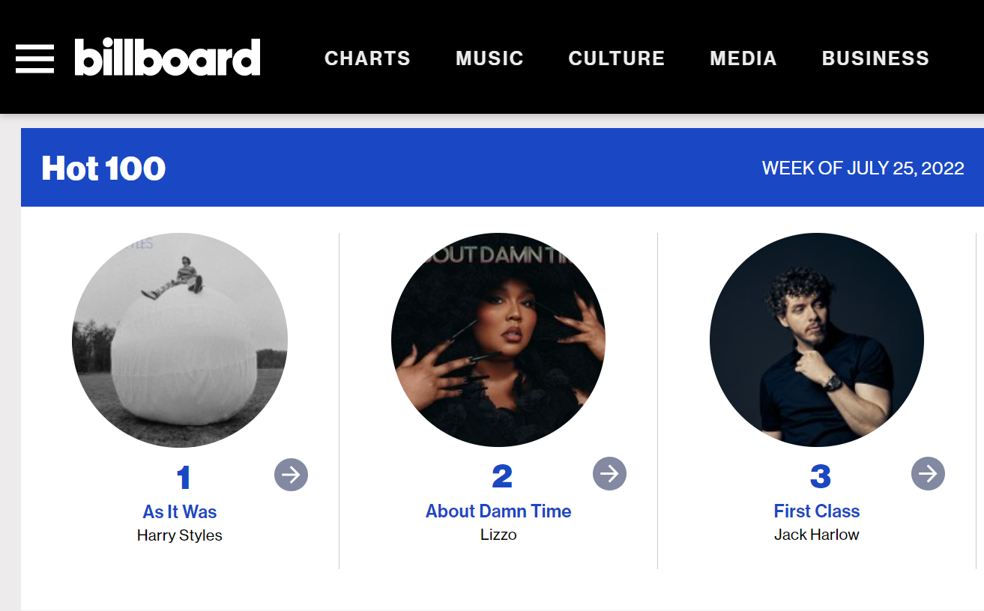
What makes a song popular on Spotify?
What variables predict song popularity?
How has year affected music trends?
How much of song popularity is predictable?
Notes:
Well, before looking at fixed numbers, we can first begin to think about what features are useful for music producers. We can also look at how music has changed within time. Are older songs not popular at all? Does what makes older songs popular tend to be different then what makes newer songs popular?
We can also ask how much of song popularity is predictable. Can we say how popular a song is based on artificial measures, or is it purely a immeasurable question of quality or even more simple, because of the artists?

Slide 6
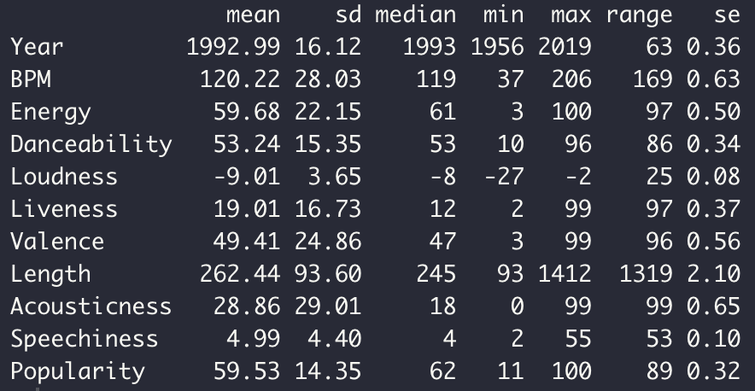
Dataset
Top 2000 songs on Spotify
Obtained from sortyourmusic.playlistmachinery.com
14 Features
3 categorical 11 continuous
Some engineered features
Popularity metric tracked by Spotify
Notes:
Our dataset records information about the most popular 2000 songs on spotify.
It contains in total 14 different features. 3 of these are categorical, namely song title, artist, and genre.
It also contains 11 continuous variables. Many of these are the measures you would expect to see, such as year produced, tempo, loudness, and length.
We also have many engineered features obtained about our data set, such as Danceability, a measure of how “dancable” a song is, “Valence”, a measure of how high energy our song is, and many more. These features, as well as the dataset were originally obtained from sortyourmusic.playlistmachinery.com,
Most important to us is a metric of popularity kept track of by Spotify

Slide 7
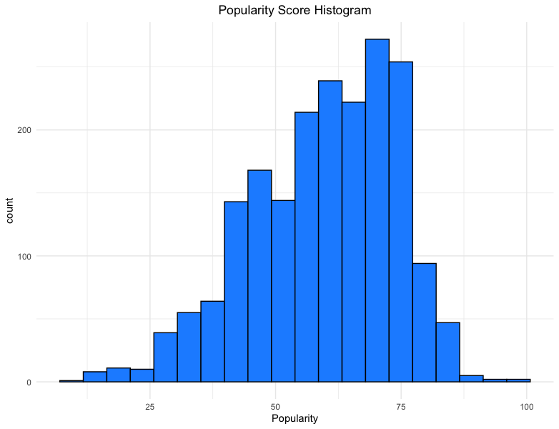
Exploratory Data Analysis

Slide 8
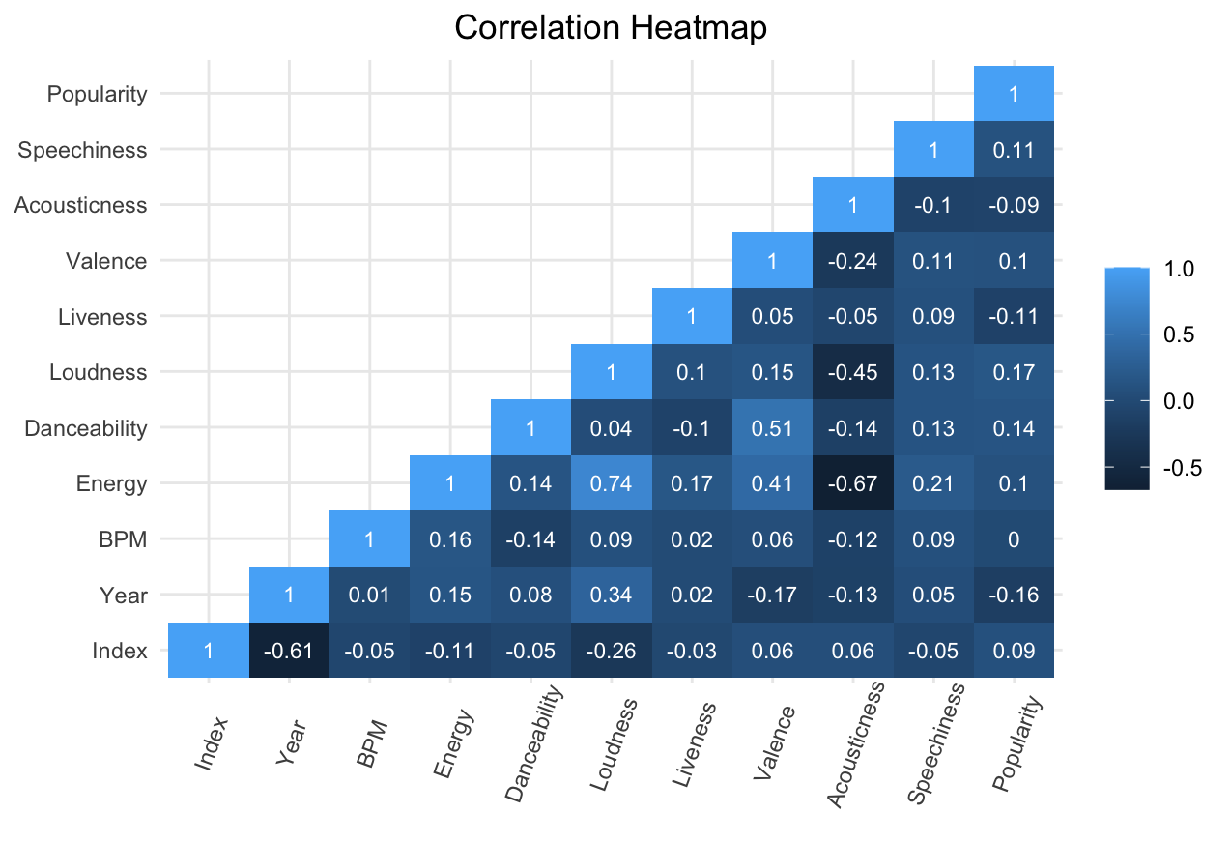

Slide 9
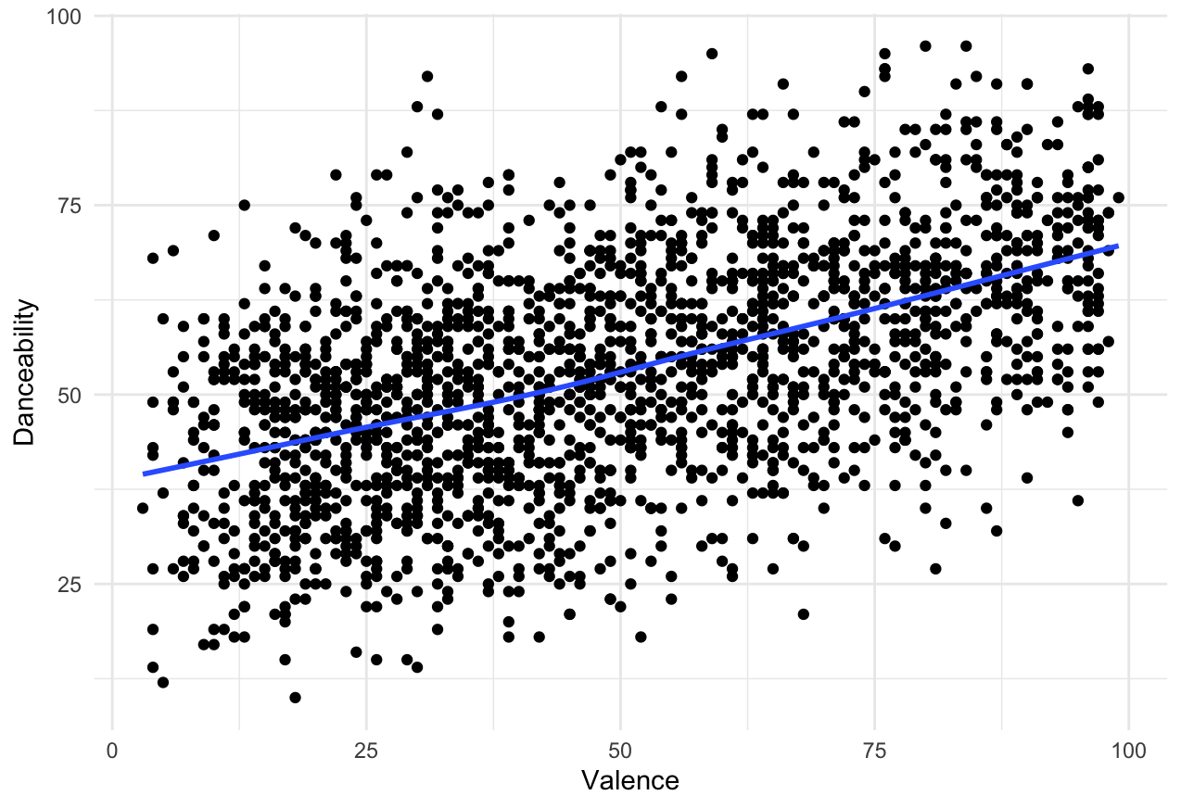
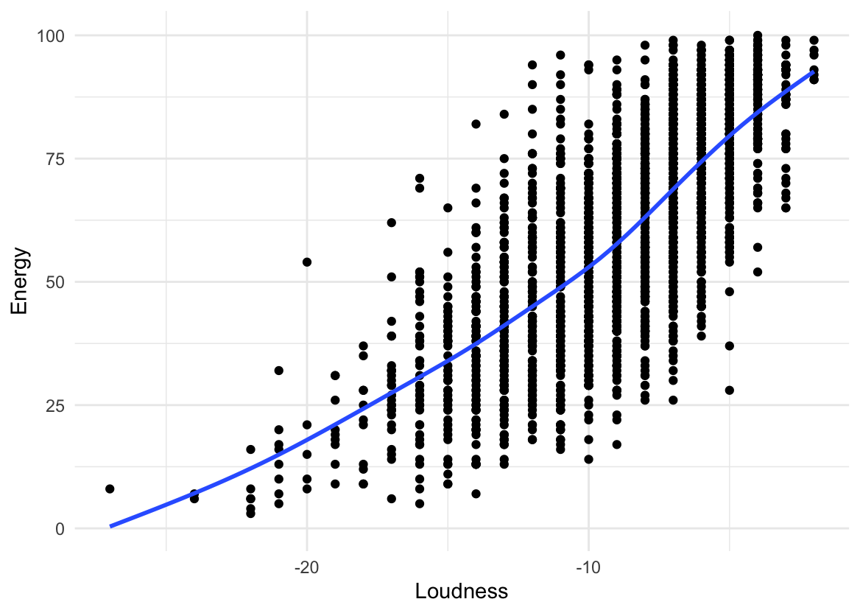
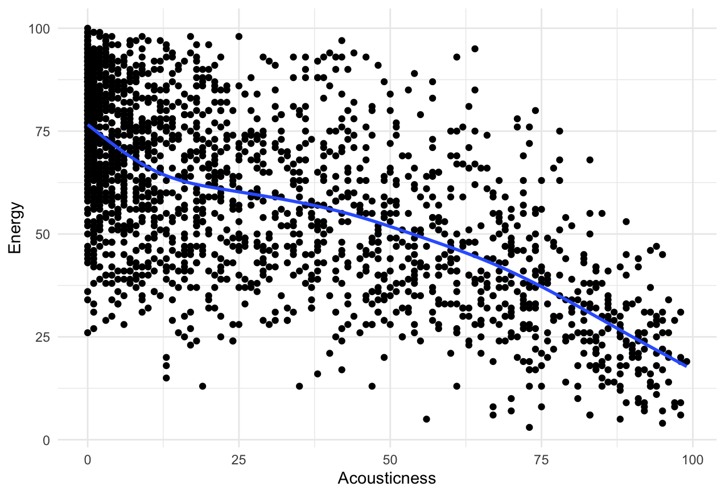
Some predictors are correlated…
Notes:
For eda- summary stats of predictors/response
-general trends
-interesting trends:
-popularity of rock music decreases

Slide 10
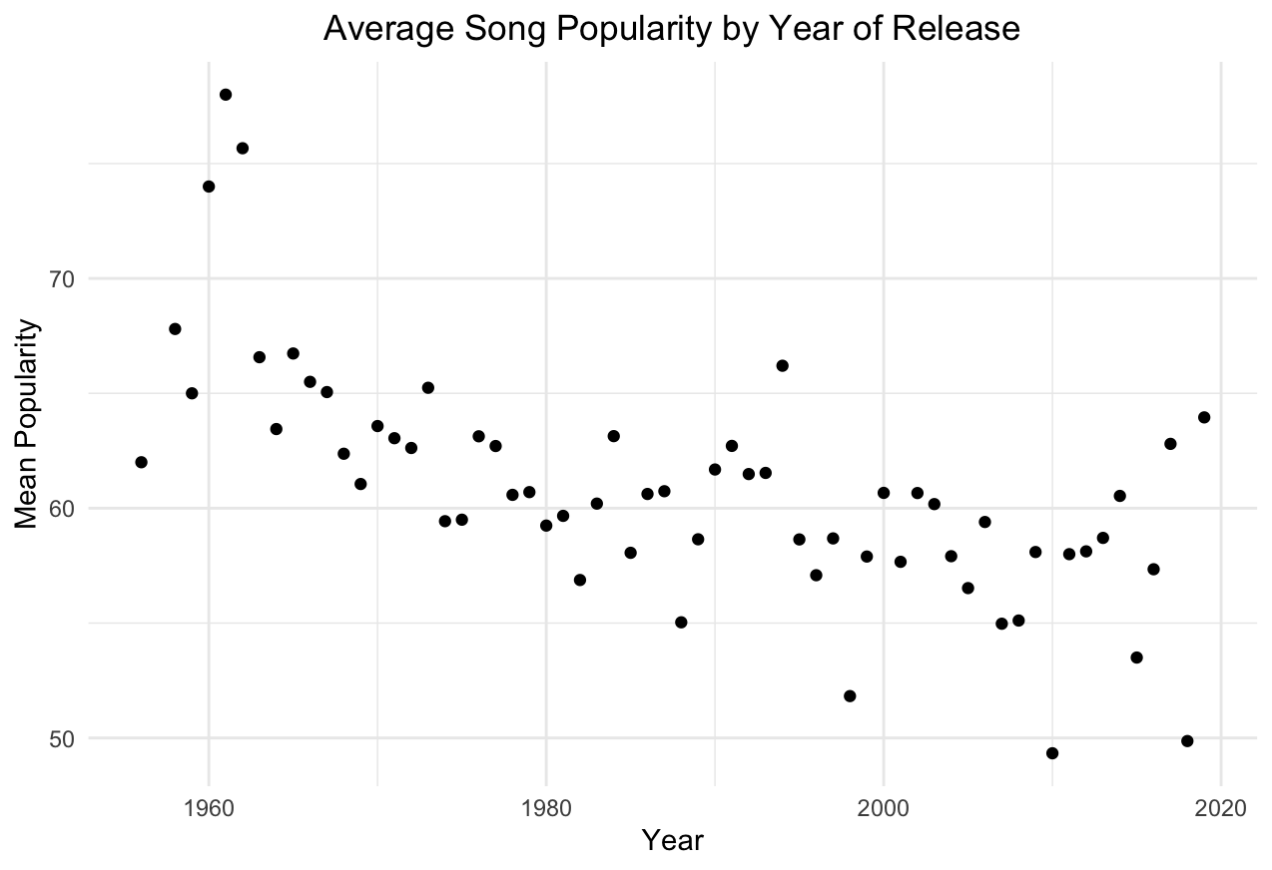

Slide 11
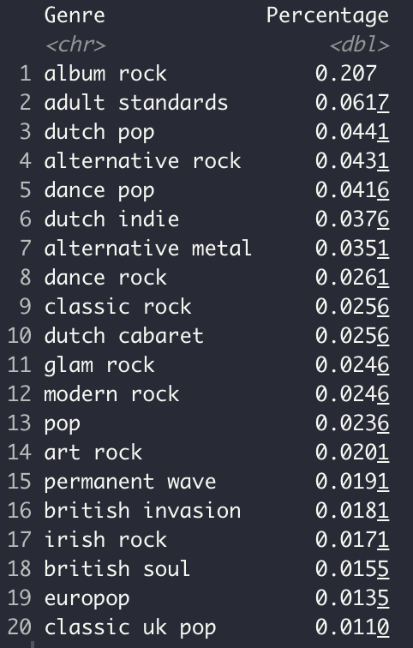
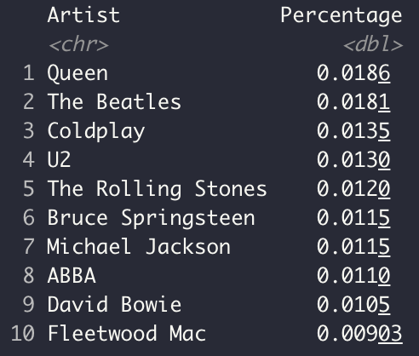
Notes:
-mention why we grouped genres

Slide 12
Feature Engineering
Clustering of Genres
# of unique genres in original dataset = 149
Most are subgenres (Eg. Album Rock, Classic Rock, Garage Rock, etc.)
We decided to extract the last word from each genre & group them together.
Notes:
-

Slide 13
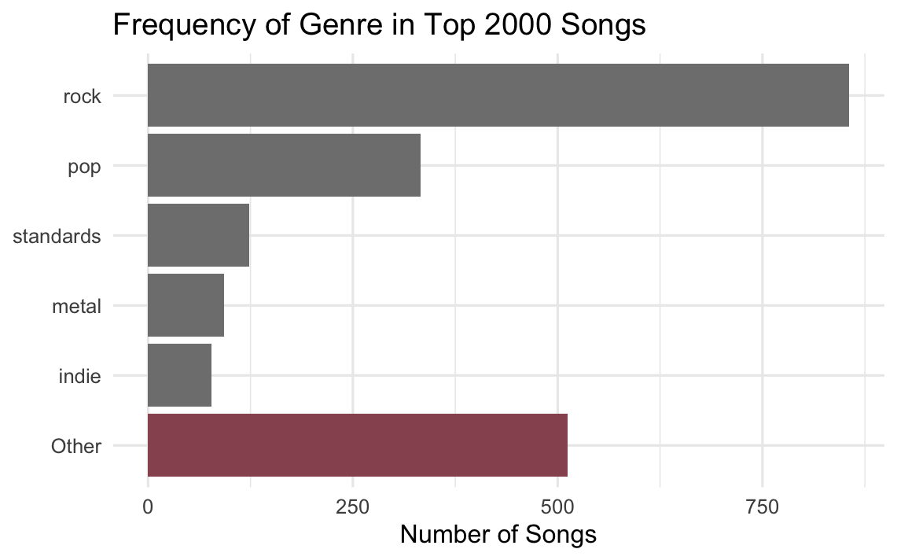

Slide 14
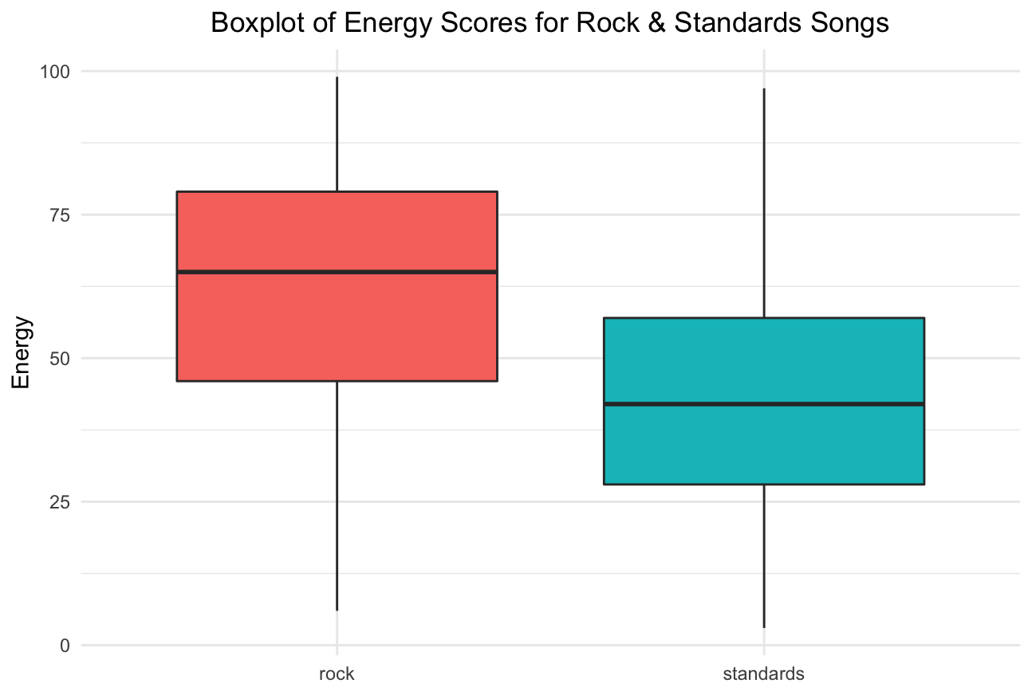
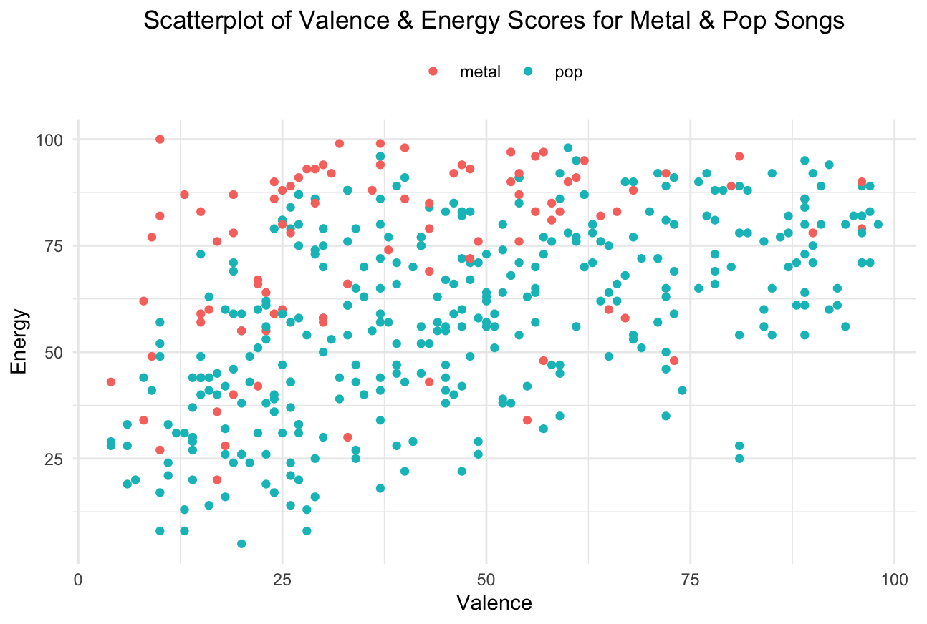
Notes:
Metal songs are typically more energetic & less positive.
Rock songs typically have more energy compared to standards
-we maintain our initial observations..
-different genres of music have different scores

Slide 15
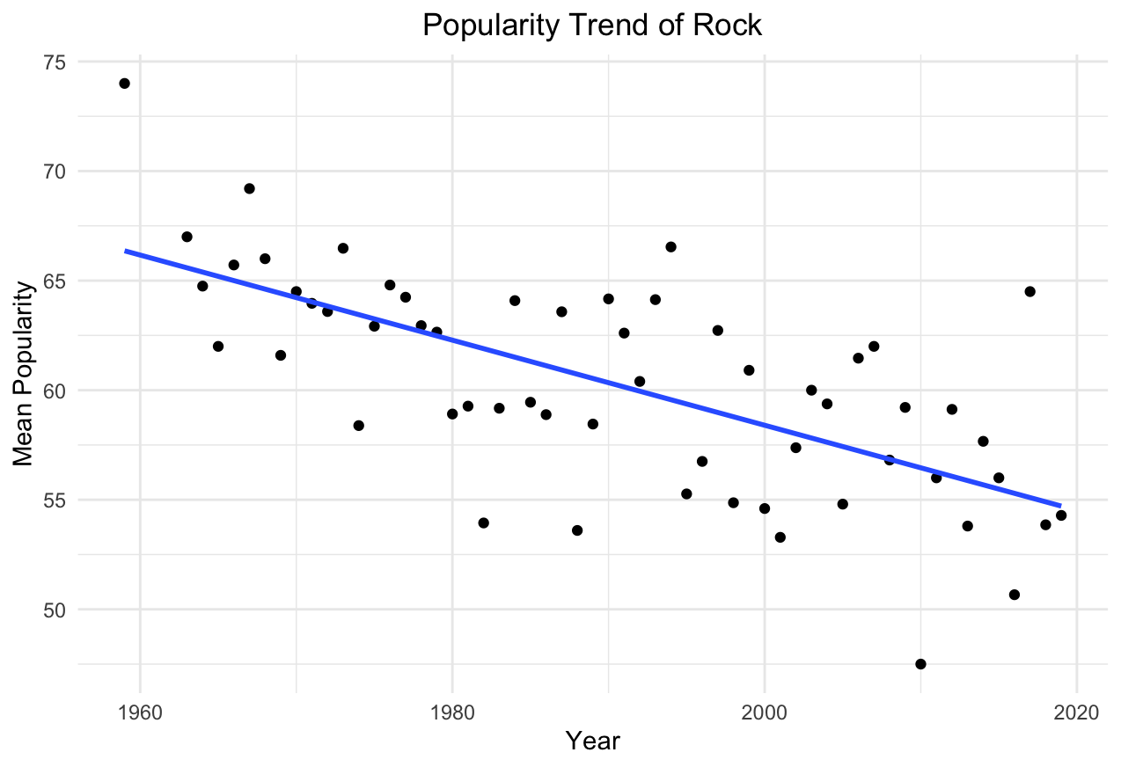
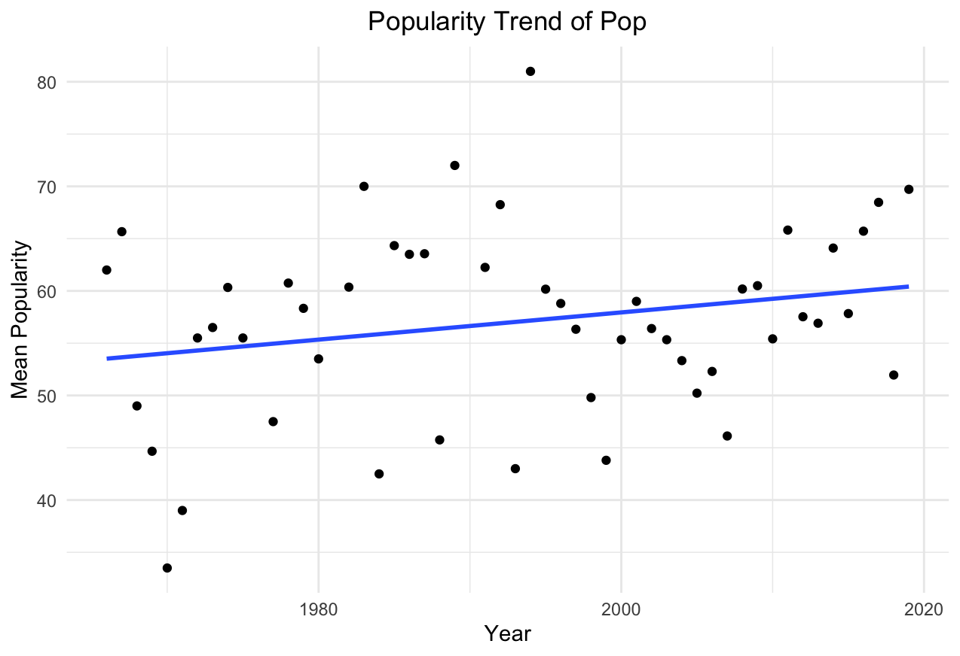

Slide 16
Modeling

Slide 17
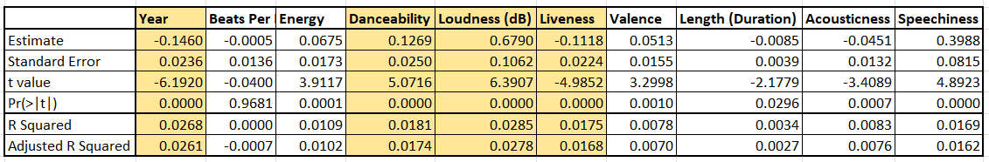
Simple Linear Regression: Each of the Predictors v. “Popularity”
The best p values were for “Year”, “Danceability”, “Loudness” and “Liveness”

Slide 18
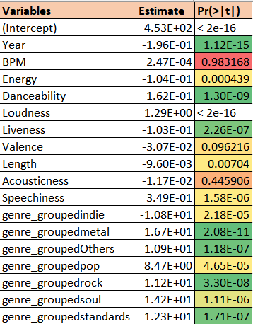
Multiple Regression
Summary statistics:
Test RMSE: 12.95
R-squared: 0.2537
Adjusted R-squared: 0.2451
F-statistic: 29.54
Notes:
Next, we tried multiple regression to see if the variables considered significant in simple linear regression still were while controlling for the remaining variables. Here, we ran a multiple regression on the dataset with the feature engineering i.e., Genre group as a feature. We see that several of the columns identified as individually significant in simple regression are still considered significant here as well. Further, our genre group feature seems to be significant as well. With this, our test RMSE has improved over the simple regression.
To improve the model, we tried subset selection & shrinkage methods on the multiple regression models. In subset selection, we did Forward, Backward & Stepwise regression.
To improve this, we decided to run this dataset with stepwise regression models along with creating dummy variables for the genres & interactions.

Slide 19
Backwards Regression
For each genre group, we converted it first to dummy variables & then creating interactions with all other fields.
Total # of predictor variables: 153
In this approach, we start with a full model & at each step gradually eliminate variables to find a reduced model which best explains the data.

Slide 20
Model summary statistics
# of variables selected = 21
Test RMSE = 12.66
R-squared = 0.2965
Adjusted R-squared = 0.2865
F-statistic = 29.57

Slide 21
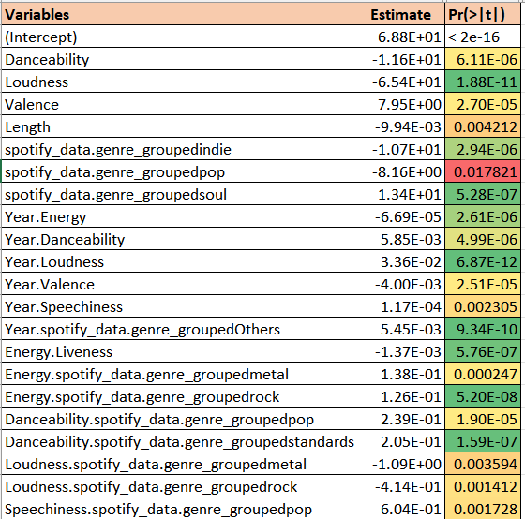
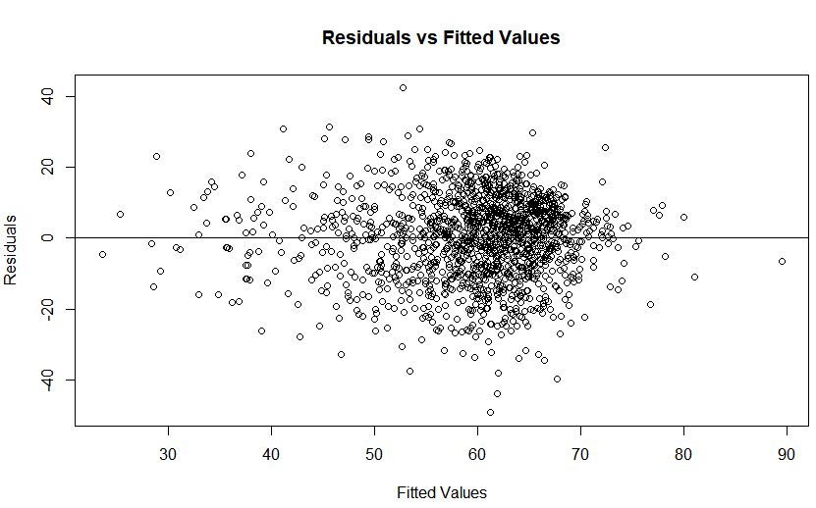
Model results
Notes:
Loudness appears as a significant predictor by itself as well as in combination with other predictors.
The interactions of year with other predictors seem to help the model predict better.
Similarly, the grouped genre field also appears as a significant predictor by itself as well as in combination with other predictors.
From the resid vs fitted values plot, we see that the errors are roughly randomly distributed. This implies that our assumption that the relationship between Popularity & the other predictors is linear is reasonable. The spread of errors is also independent of the fitted values -> constant variance of the errors.

Slide 22
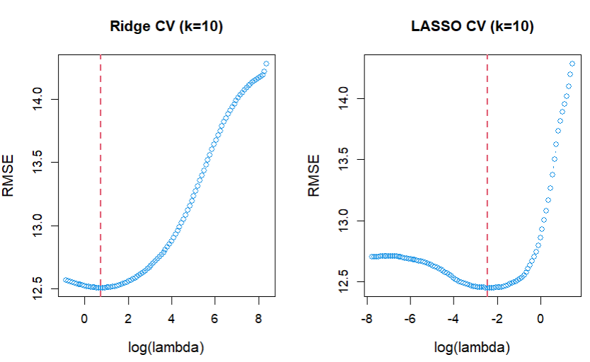
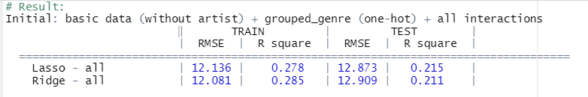
Shrinkage Method - Ridge & Lasso
Shrinkage method: Focus on the important variables by fixing constraints.
Ridge 𝝺 : 0.46
Lasso 𝝺 :-2.35. (51 sets with non-zero coefficients.)
Shrinkage Method Results: Grouped Genre + interacted with all numeric fields.
Notes:
This part we will talk about the Shrinkage method. We wanted to have the constraint in place so that the estimation procedure will be able to focus on the important variables.
First we did the variable Scaling, then interaction with numerics and grouped genre, also the cross validation to come up with the best lambda which makes the model not too simple but not too complex!
lambda : under log e for (1) ridge you get 0.43 (2) lasso you get -2.35 which have 51 sets that has non-zero coefficients.
By doing the three Scenarios: (1) all numerics+grouped genre+interaction (2) all numerics+grouped genre+genre does not interact (3) only numerics
We came up with the RMSE of 12.873 which is still not lower than what we have in backward regression.

Slide 23
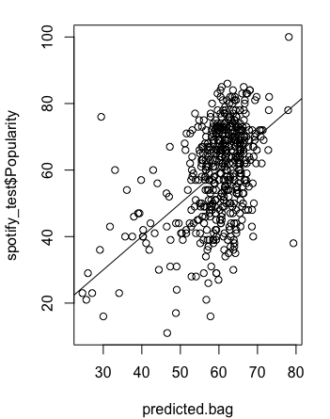
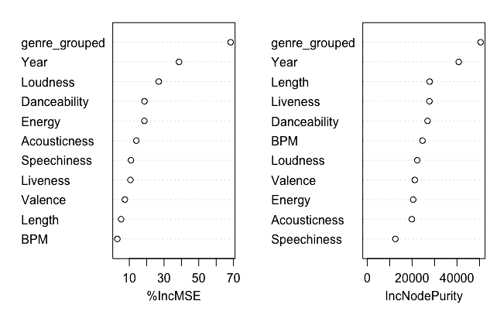
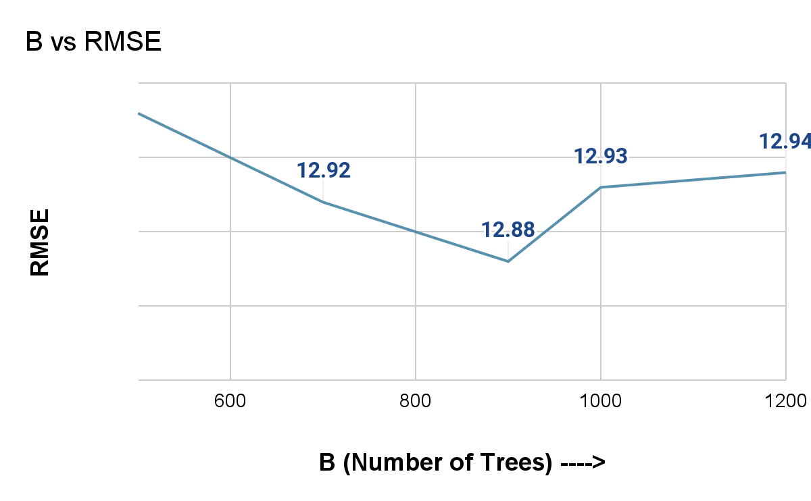
Bagging
Bagging (or Bootstrap Aggregating) technique tries to implement similar learners on small populations and then takes a mean of all the predictions
B : Number of bootstrap samples
Variable Importance - Genre, Year, Loudness, Danceability, Energy
RMSE = 12.88
Notes:
In Bagging (or Bootstrap Aggregating) technique tries to implement similar learners on small populations and then takes a mean of all the predictions
We tried with different number of trees to tune the model and find the min RMSE. For B as 900, we received the min RMSE i.e., 13.24
By the chart of %IncMSE we can see that genre, Year, loudness significantly contribute to reduce the MSE

Slide 24
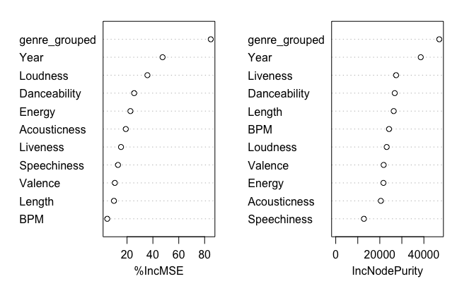
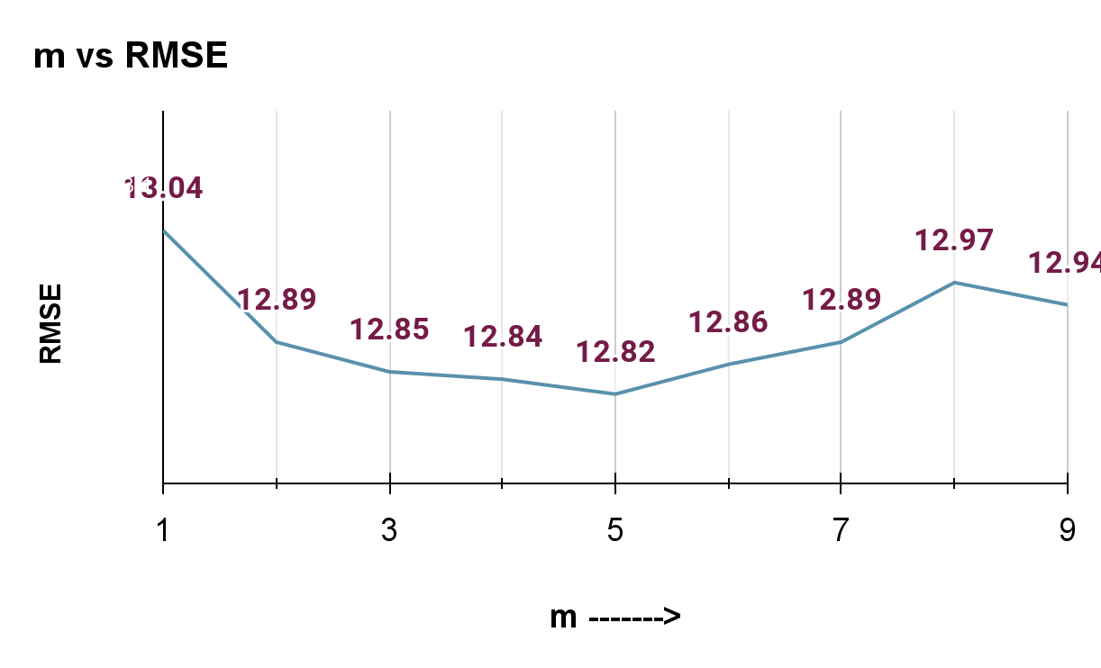
Random Forest
The random forest is an algorithm consisting of many decisions trees.
B : Number of bootstrap samples = 1000
m : number of variables to sample = variable
(Feature randomness)
Variable Importance - Genre, Year, Loudness, Danceability, Energy
Notes:
Next we tried Random Forest,
Random forest is similar to boosting but here feature randomness is included, so in a given tree only a subset of variables are used to predict.
When tried different variables count and plotted RMSE against it, variable count as 5 gave the min RMSE.
By the chart of %IncMSE we can see that genre, Year, loudness significantly contribute to reduce the MSE

Slide 25
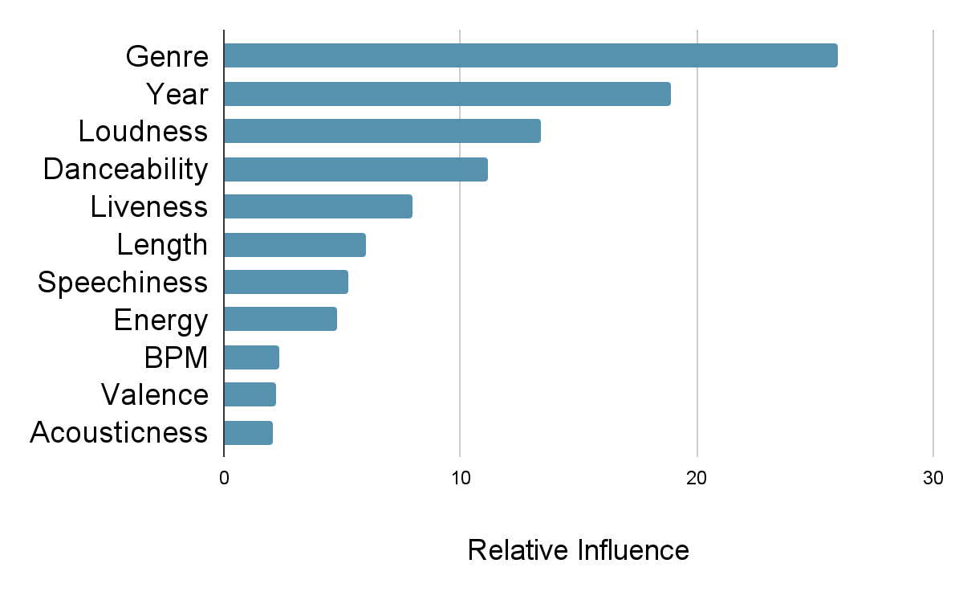
Boosting
Different combination of B, d and 𝝺
Ensemble method that produces a overall fit from many trees
Tdepth(d) : Size of each tree
Ntree(B) : Number of trees
𝝺 : The Crush factor
Tdepth (d) | Ntree (B) | Lambda (𝝺) | Out of sample error
4 | 50 | 0.200 | 12.77
4 | 100 | 0.200 | 13.00
4 | 20 | 0.200 | 13.02
4 | 40 | 0.200 | 12.69
4 | 40 | 0.001 | 14.45
4 | 50 | 0.001 | 14.43
4 | 100 | 0.001 | 14.34
10 | 40 | 0.001 | 14.43
10 | 50 | 0.200 | 13.29
Notes:
Boosting is an ensemble method that produces a overall fit from many trees.
We tried different model parameter combinations, that are Tree depth, number of trees and the crushing factor to find the optimum combination.
We started with Tree depth as 4, number of tree as 5 and crushing factor as 0.2. When increased the number the trees the RMSE increased but decreased a bit with lesser number of trees.
For that model, the predicting variables chart for relative Influence shows that Genre, Year, Loudness are very important.

Slide 26
Conclusion
Show the table with all models we tried along with their RMSE
Discuss which model we’re going with & why (prolly lin. Reg for its interpretability)
Summarize the project & closing words
Notes:
Change to a heading slide

Slide 27
Conclusion

Slide 28
Backward Selection
Attempted many models
Backward Selection produced minimal OOS RMSE
Had good explainability
Relatively few predictors
Notes:
12.66 RMSE
21 predictors

Slide 29
Conclusions
Most of popularity unpredictable
Despite that some of popularity is predictable
Variable interaction present
Notes:
As we might expect, most of popularity wasn’t predictable from out dataset, as one would hope for the state of people’s taste in music.
Despite this, we were still able to explain much of the variation in popularity with our model. We saw that, on average, songs that were louder were less popular, ceteris parabis. Or that songs grouped in the pop genre tended to do worse, again, keeping constant all other predictors in our model.

Slide 30
Future steps & Improvements
Get more data
Improve genre grouping
Convert popularity to categorical variable
Create more models
Notes:
One thing we could do is receive more data. As it stands the top 2000 list is biased only towards very popular songs, and therefore isn’t super generalizable to general songs.
Genre grouping can also be improved. We could use clustering methods to try and group genres together in a more logical way. We could also manually look through genres and use our better judgement to group points together.
Lastly, we could convert popularity into a discrete variable by binning, and attempt different classification methods.

Slide 31
Thank you

Slide 32
Appendix

Slide 33
About the dataset:
We analyzed a dataset containing audio statistics for the all-time top 2000 tracks on Spotify from 1956 to 2019. Using a variety of regression methods, we hoped to predict the popularity of a song given it’s quantitative and qualitative characteristics.
Contents of the dataset:
Index: ID
Title: Name of the Track
Artist: Name of the Artist
Top Genre: Genre of the track
Year: Release Year of the track
Beats per Minute(BPM): The tempo of the song
Energy: The energy of a song - the higher the value, the more energetic the song
Danceability: The higher the value, the easier it is to dance to this song.
Loudness: The higher the value, the louder the song.
Liveness: Detects the presence of an audience in the recording. Higher liveness values represent an increased probability that the track was performed live.
Valence: The higher the value, the more positive mood for the song.
Length: The duration of the song.
Acoustic: The higher the value the more acoustic the song is.
Speechiness: The higher the value the more spoken words the song contains
Popularity: The higher the value the more popular the song is.
#Certain variables from the dataset are not useful in predicting song popularity, so models were constructed with this in consideration
-discuss how we adjusted data for our models. Grouping genres, etc
Notes:
Perhaps change this to show summary statistics of data. Name the most important variables but make it less boring
-explain our response variable, and number of predictor variables as well as number of observations in dataset

Slide 34
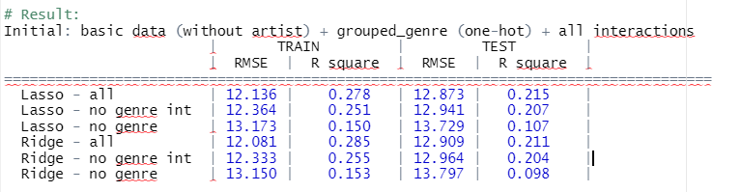
Results using Shrinkage Method
Under three-Scenarios for Ridge and Lasso:
Grouped Genre (2% cutoff) with numeric fields +dummy vars (each genre)+ interacted with all numeric fields
Grouped Genre (2% cutoff) with numeric fields +dummy vars (each genre)+ does not interact with all numeric fields
Only numeric fields & interaction

Slide 35
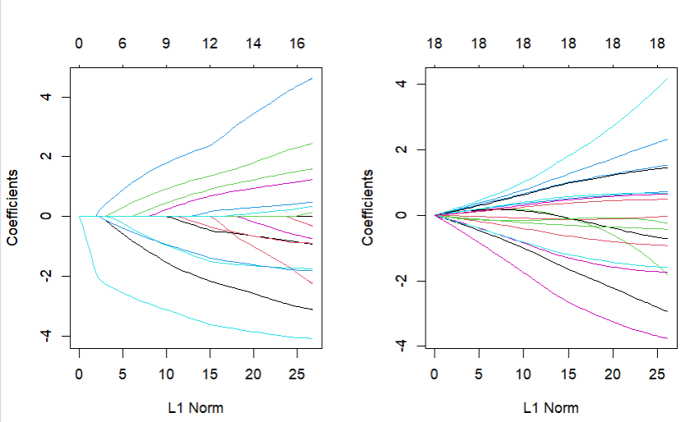
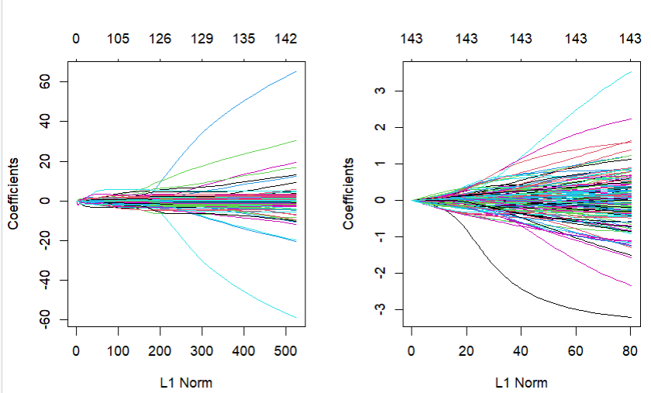
Ridge & Lasso- Coefficient Results
Only numeric field::
Including interaction with grouped genre:

Slide 36
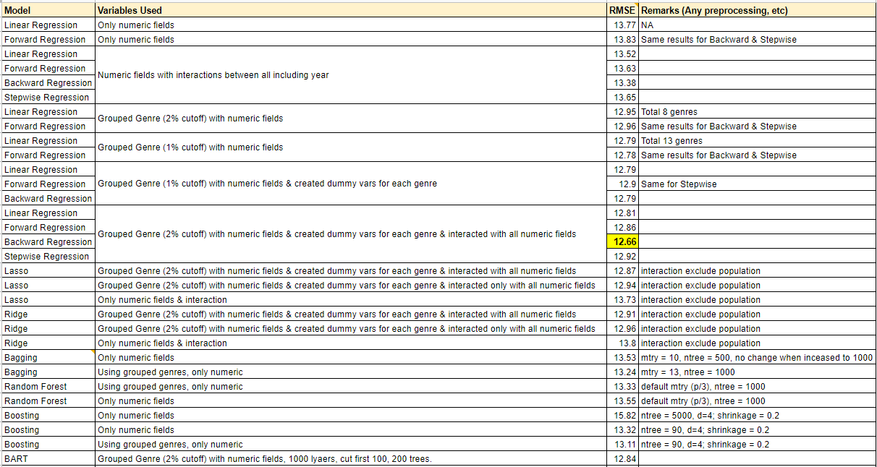
Summary of models tried
Notes:
Over here we have a list of all models tried for linear regression. In the highlighted row, we see that the reduced model obtained by backward regression marginally had the lowest RMSE. We also chose it over the tree and ensemble methods, due to the ease of explaining.

Slide 37
Correlation and Linear Regression between each of the Predictors and the Response [Contd]
While the above results do not show a very strong relationship between the predictors and the response, the best values were for “Year”, “Danceability”, “Loudness” and “Length”.
They are the predictors with the lowest standard errors, as well as the lowest p values (and lowest RMSE) of the available predictors.
Hence, we tried the cross-correlation and multiple regression with the selected predictors and the response, as in the next slide.

Slide 38
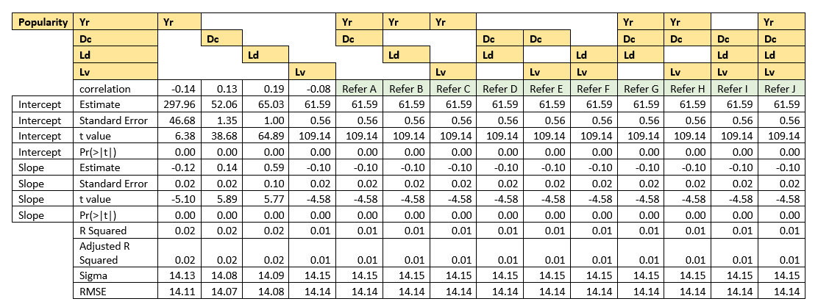
Correlation and Linear Regression between the selected of the Predictors and the Response

Slide 39
Correlation and Linear Regression between the selected of the Predictors and the Response [Contd]
The p values are very low, and hence there is a good chance that the predictors selected contribute significantly to the response.
However, the p values are higher with multiple regression than simple regression.

Slide 40
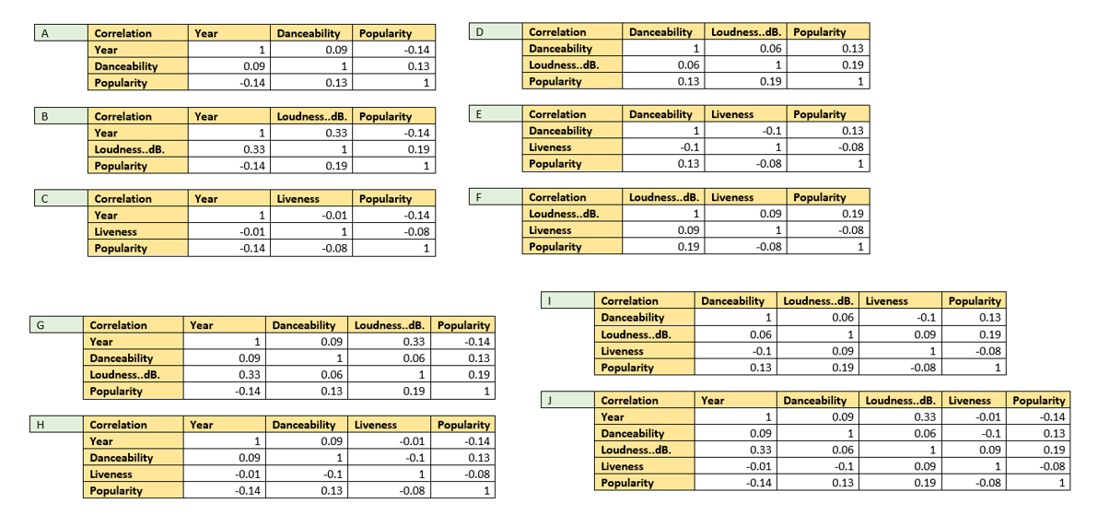
Correlation values (selected values)

Slide 41
Model output
Linear Regression - The variables used, plots , RMSE
Ridge & Lasso
Trees - Output of variable selection
Bagging
Random Forest
Boosting
BART

